Slide 1

STRIPE CONNECT
StripeConnect
PAYOUT ANALYSIS
Presented by: Monalika Pradhan

Slide 2

AGENDA
01
02
03
Data Overview and Cleaning
EDA
Question 1
04
05
06
Question 2
Question 3
Future Work

Slide 3

Dataset Overview and Cleaning
Contains the payout details on each date
payouts.csv
Contains the list of industries that make
the payouts
industries.csv
Contains the list of countries the payouts are made to
countries.csv
Removed missing and duplicate values
Null and Duplicate values
Handled outliers and removed unncessary columns
Outliers and other columns
Final Dataframe after merging

Slide 4

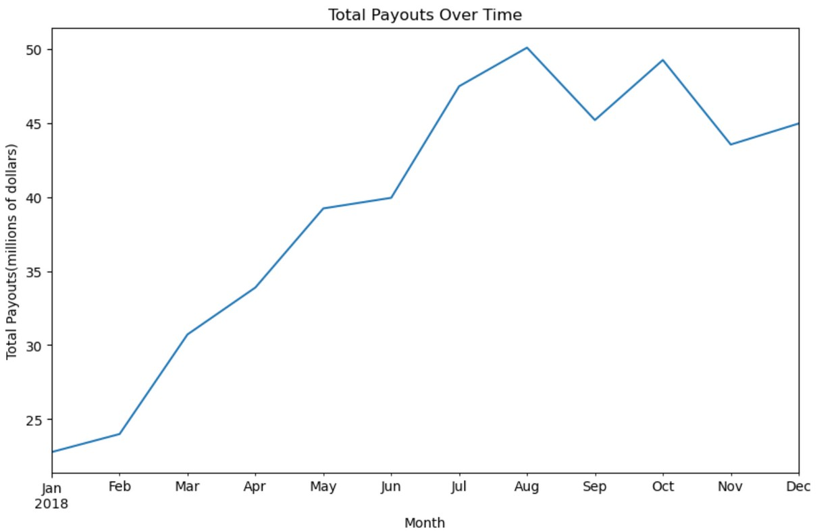

Exploratory Data Analysis
General Upward Trend: Total payouts show a consistent increase throughout the year, indicating overall growth.
Seasonal Variations: Clear cyclic patterns observed:
Significant rise from March to May.
Peak in August, the highest point in the year. Decline post-August, with a notable dip in September.
Rise in October followed by a decline in November and subsequent increase in December.
End-of-Year Behavior: Decrease in total payouts in November and December, possibly indicating seasonal decrease in activity or policy changes.
Volatility: Monthly changes suggest volatility, possibly due to market conditions, business cycles, or specific events.

Slide 5
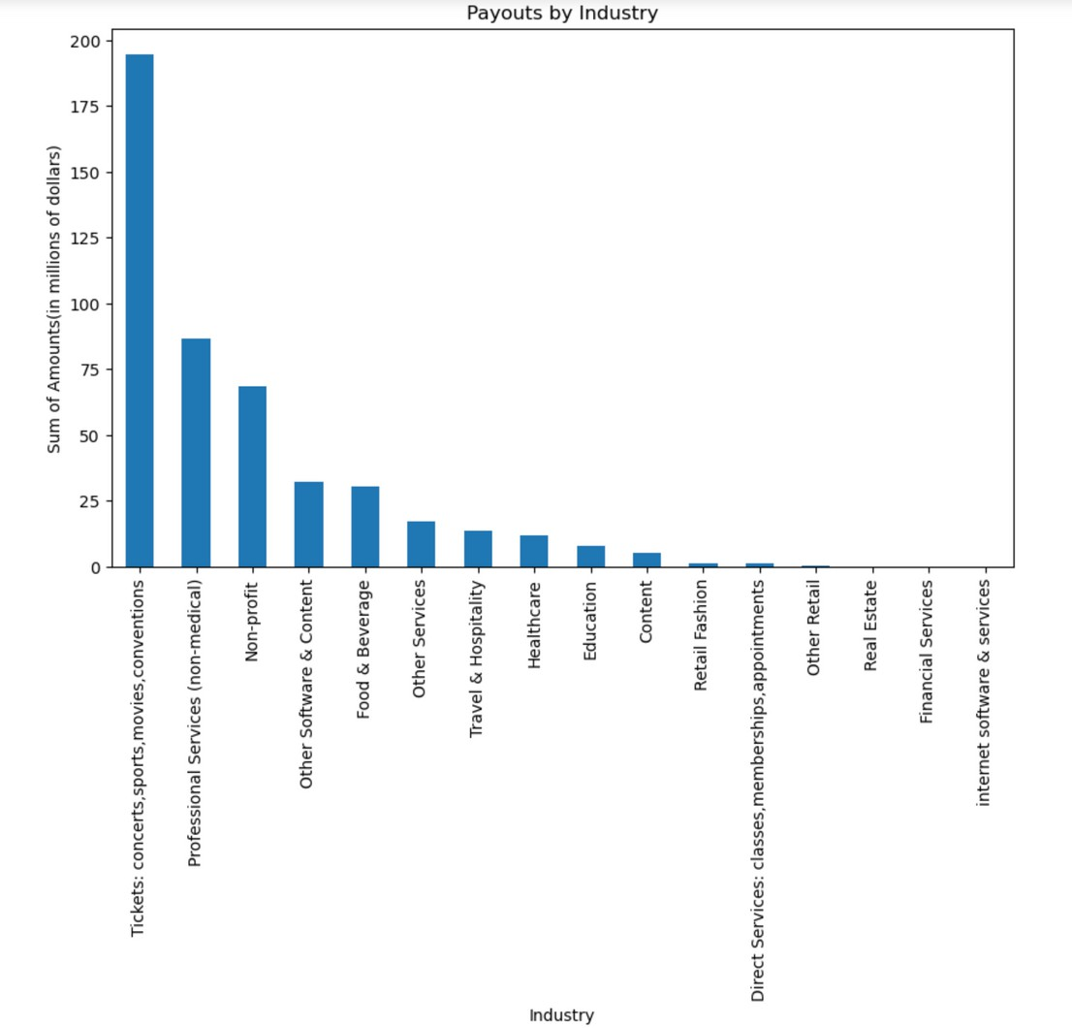
Total Payouts by Industry
High Activity Sectors: Ticket, Concerts, Sports, and Movies dominate payouts, nearing $200 million.
Notable Recipients: Professional Services and Non-profits receive
$50 to $100 million, indicating significant funding or grants.
Moderate Payouts Across Diverse Industries: Sectors like "Other Services" & "Content," "Food & Beverage," "Travel & Hospitality," "Healthcare," and "Education" show moderate payouts around $25 to
$50 million.
Lower End Payouts: Industries like "Direct Services," "Other Retail," "Real Estate," "Financial Services," and "Internet Software & Services" receive less than $25 million.
Variation in Payouts: Influenced by industry size, external factors, and operational differences.
Economic Indicators: Higher payouts may signal robustness or compensation issues, while lower payouts could indicate less economic activity or smaller scale.
Snapshot of Activity: Offers insights into economic health across sectors for stakeholders and analysts.

Slide 6
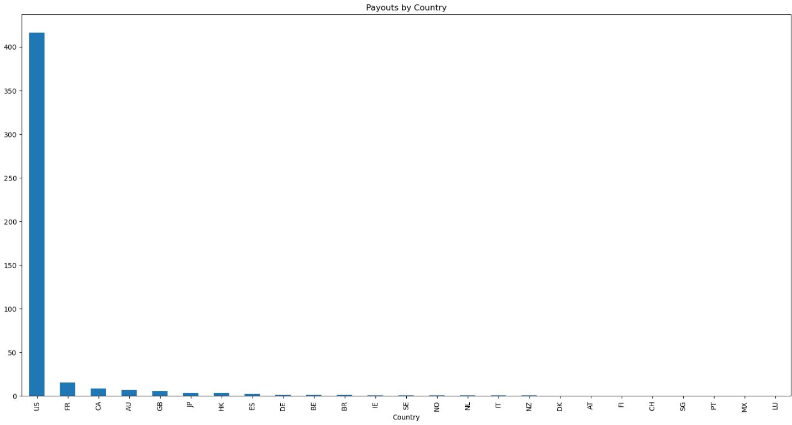
Total Payouts by Country
US Dominance: High payouts reflect Stripe's primary market status.
Market Comparison: Other countries exhibit lower payouts, signaling varying market maturity.
Global Strategy Insights: Payout distribution guides global expansion efforts.
Revenue Risk: Concentration in the US poses revenue risks, necessitating diversification.
Currency Impact: Local currency transactions affect payout figures.
Economic Footprint: Payouts indicate Stripe's market success and growth potential in each region.
Resource Allocation: Data guides investment decisions and resource allocation.
Market Development: Smaller payout markets offer growth opportunities through tailored strategies.

Slide 7
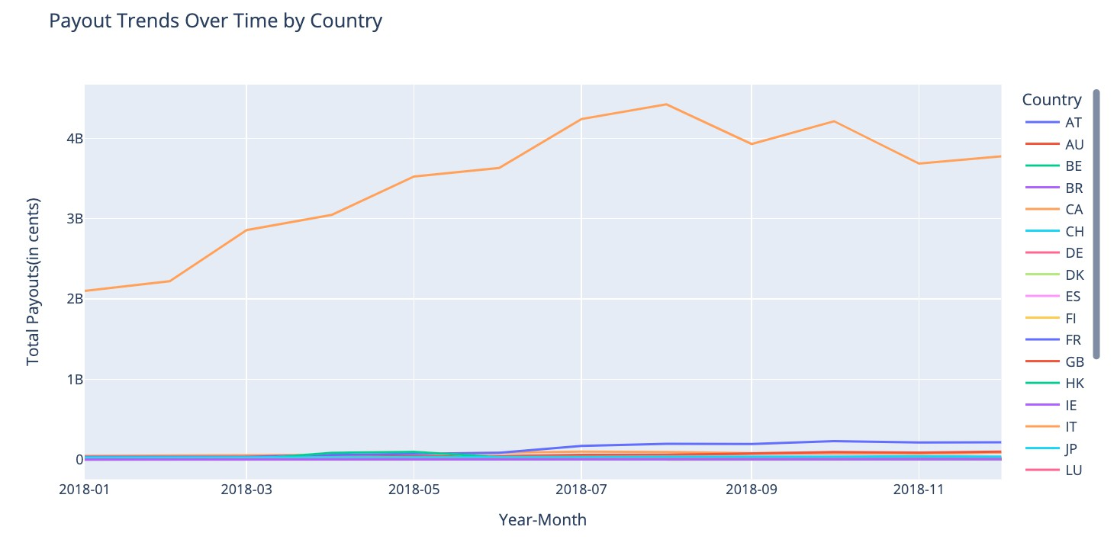
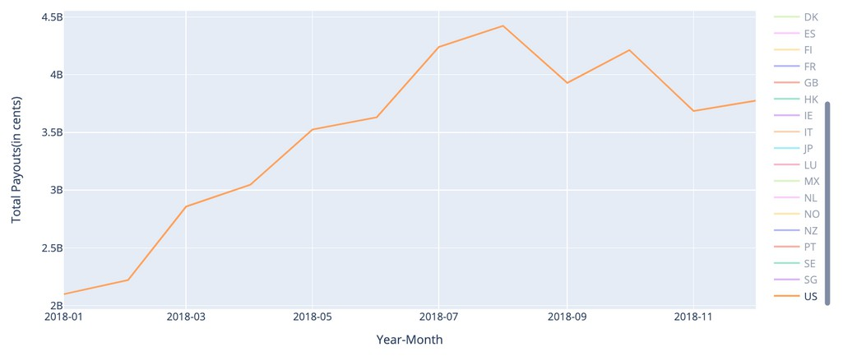
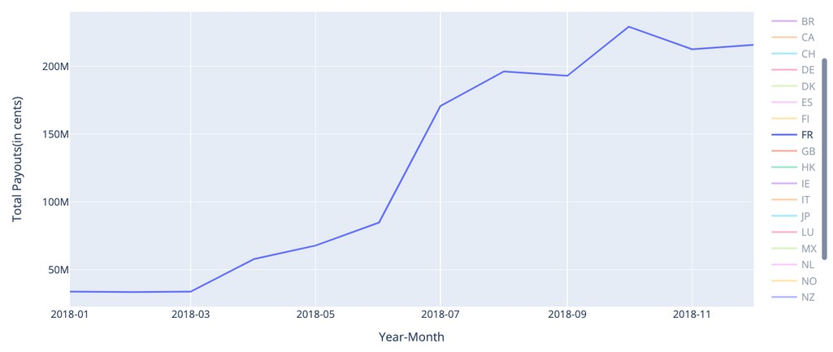
Interactive country-wise total payout trends over time (2018)
UNITED STATES
FRANCE

Slide 8




Using the data provided, please provide an estimate for the amount of money we should
expect to be paid out to each country on Jan. 1 , 2019 (the day after the last day in the dataset).

Slide 9
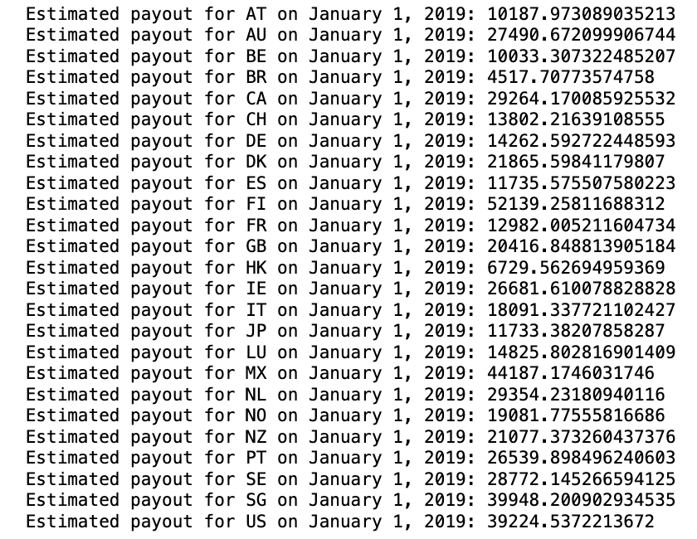
Estimation using average payout projection per country
Data Preparation:
Convert 'date' column to datetime format.
Filter dataset to include data up to December 31, 2018.
Calculation of Averages: Group historical data by country.
Calculate average payout for each country based on data up to end of 2018.
Estimation for January 1, 2019:
Create empty dictionary for estimated payouts. Loop through each country in average payout data. Filter historical data for each country.
Recalculate average payout for specific country.
Add entry to dictionary with country code as key and calculated average payout as value.
Output:
Print estimated payouts for each country on January 1, 2019, based on historical averages up to December 31, 2018.

Slide 10
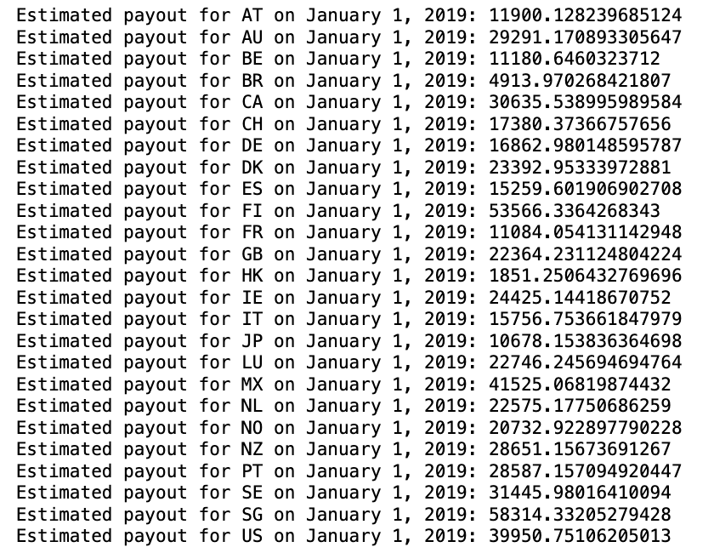
Estimation using Linear Regression
Data Preparation:
Convert 'date' column to datetime format and localize to UTC timezone.
Filter dataset to include data up to December 31, 2018.
Linear Regression Model: Calculate average payout per country. For each country, filter historical data.
Prepare data for linear regression: X as day of the year, y as payout amount.
Model Training and Prediction:
Fit linear regression model for each country. Predict payout for January 1, 2019, using fitted model.
Result Storage and Output:
Store prediction in dictionary with country as key. Print estimated payouts for each country on January 1, 2019, based on model predictions.

Slide 11
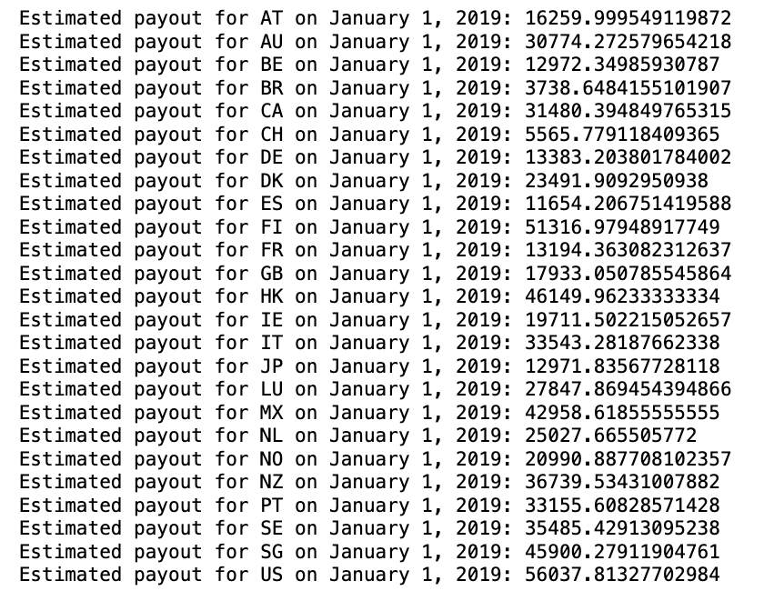
Estimation using Random Forest Algorithm
Data Preparation:
Convert 'date' column to datetime format and localize to UTC timezone.
Filter dataset to include data up to December 31, 2018.
Modeling Preparation:
Calculate average payout per country (for reference). Extract country-specific data.
Prepare inputs for Random Forest model: X as day of the year, y as payout amounts.
Random Forest Regression:
Instantiate Random Forest regression model for each country with specified parameters.
Train the model using country-specific data.
Prediction:
Calculate day number for January 1, 2019, from minimum date in dataset.
Predict payout for January 1, 2019, using trained model.
Result Storage and Output:
Store predictions in dictionary with country as key.
Print estimated payouts for each country on January 1, 2019.

Slide 12
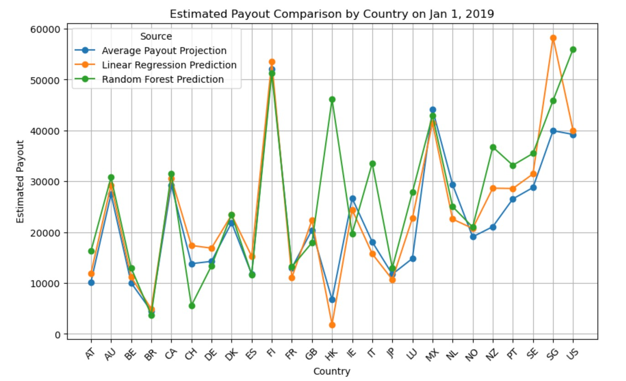
Varying Estimates:
Noticeable variation in estimated payouts among different models suggests each captures different aspects of data or has different sensitivities.
Model Agreement:
Consensus in some countries indicates clear trends or less volatility in historical data.
High Variability:
Comparison of the estimation
Significant discrepancies in certain countries could stem from outliers, noise, or non-linear patterns.
Peak Predictions:
Some countries show peak predictions, suggesting higher payout activities or seasonal spikes.
Low Predictions:
Other countries exhibit consistently lower estimated payouts, possibly indicating lower activity levels.
Country-Specific Trends:
Random Forest model shows more fluctuation, indicating sensitivity to non-linear trends, while Linear Regression provides smoother estimates.
Model Preference:
Consistent accuracy against actual payouts can indicate superiority or suitability of a particular model.
Actionable Insights:
Insights help identify target countries for business development or risk mitigation strategies.
Model Improvement:
Differences between predictions can inform model refinement, such as incorporating seasonal effects or market-specific factors.
Strategic Decisions:
Consensus on growth in certain countries suggests capitalizing on increasing markets, while lower predictions may require stimulating growth strategies.

Slide 13

Assume that one year from the end of the dataset, we will have 15 platforms from the Education
industry, 5 from Hotels, Restaurants & Leisure and 40 from Food & Beverage. How much total payout volume do you expect to see on a typical day in
2019, from these three industries?

Slide 14
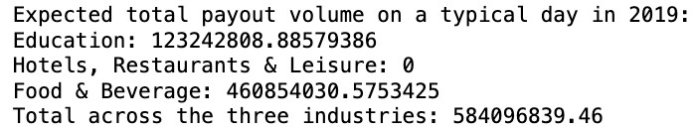
Calculate Daily Totals and Averages
Compute daily_totals by summing 'amount' for each industry and date group.
Calculate daily_averages by taking the mean of daily_totals grouped by industry.
Define platforms_2019 dictionary indicating expected platforms for three
industries.
Expected Number of Platforms in 2019
Initialize expected_payouts_2019 dictionary.
Iterate over platforms_2019, retrieving historical daily average payout for each industry.
Calculate expected_payout by multiplying historical average payout by expected platforms in 2019.
Store calculated expected_payout in expected_payouts_2019 dictionary.
Estimate Expected Daily Payout Volume
Sum all expected daily payout volumes across industries to compute total_expected_payout_2019.
Calculate Total Expected Payout Volume
Display the Results
Print expected daily payout volume for each industry and total for all industries combined, formatting total to two decimal places.

Slide 15

Given this data, what metrics would you define and track in order to help product and business teams understand the progress and behavior of Stripe
Connect?

Slide 16



Distribution Metrics: Country-wise Distribution Industry-wise Distribution Recipient Concentration
Volume Metrics: Total Payout Volume Average Payout Size Growth Rate
Operational Metrics:
Error Rate
Customer Support Queries
Temporal Metrics:
Seasonality Time to Payout
Innovation and Growth Metrics: New Market Penetration Platform Retention Rate
Operational Metrics:
Error Rate
Customer Support Queries Innovation and Growth
Visualization and Reporting:
Dashboards Trend Analysis
Geographical Analysis Industry Comparison
Metrics:
New Market Penetration Platform Retention Rate

Slide 17


Advanced Techniques
Employ advanced analytical techniques including time series forecasting, machine learning models, clustering analysis, anomaly detection, causal inference models, sentiment analysis, and cross- industry/country analysis.
Growth and Success
These approaches enable better prediction of payout
behaviors, understanding of market dynamics, optimization of operations, and strategic expansion, contributing to Stripe's growth and success in the fintech industry.

